Slide 1
MCB 3421
ATP binding sites –
Shared Ancestry versus Convergent Evolution

Slide 2
The most common fold in proteins is the Rossmann fold occurring in most nucleotide binding proteins. Examples are the V-/F-/A-ATPases, helicases, P-type ATPases, myosin ….
At the core of the fold is a beta alpha beta fold, and the presence of the so-called Walker motifs.
(From http://proteopedia.org/wiki/index.php/Rossmann_fold)

Slide 3
It is conceivable that all the Rossmann fold domains are homologous, but the beta alpha beta arrangement is rather simple, and one cannot exclude the possibility of convergent evolution (i.e., the Rossmann fold in ATP synthases, might not have common shared ancestry with the Rossmann fold in P-type ATPases, ABC transporters, or the NADH binding 3-phosphoglycerate dehydrogenase)
“The basic nucleus of the βαβ fold is about 30 residues. In many proteins that do not share any significant sequence homology, there exists an extensive tertiary structural homology beyond this 30 residue segment, particularly in specific domains that bind dinucleotides. Therefore, the probability that this type of extensive structural homology evolved independently is very low. Thus, most likely βαβ fold represents an ancient structure that left its vestige in numerous proteins. Certainly, this conclusion does not exclude the possibility of independent convergent evolution.” From http://proteopedia.org/wiki/index.php/Rossmann_fold

Slide 4
GRASP ATP binding site
A second unrelated ATP binding domain is the GRASP domain. Examples are D alanin – D-Alanin ligase, glutathione synthetase, carbamoyl phosphate synthetase and many other enzymes that use the energy from ATP to ligate two substrates.

Slide 5
GRASP ATP binding sites

Slide 6
Rossmann, ATP GRASP, in vitro evolution
The Rossmann and GRASP domains evolved through natural selection.
Using an approach similar to the selection of substrate binding aptamers (RNA) in the selex approach (co-invented by former UConn undergraduate Larry Gold), Keefe and Szostak used Puromycin to link the synthesized protein to the encoding DNA. (labelled as RNA diplay)

Slide 7
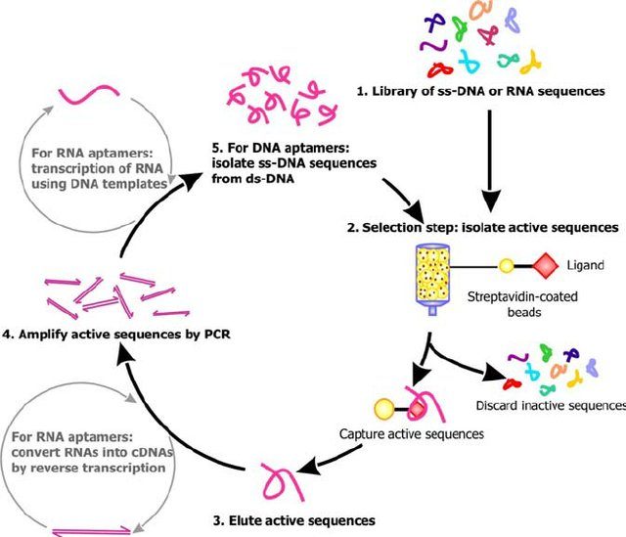
SELEX

Slide 8
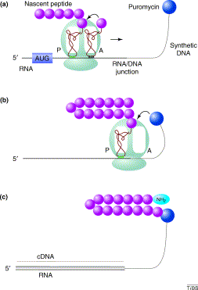
RNA display
from https://www.sciencedirect.com/science/article/pii/S0968000403000367

Slide 9
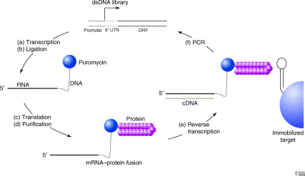
from https://www.sciencedirect.com/science/article/pii/S0968000403000367

Slide 10
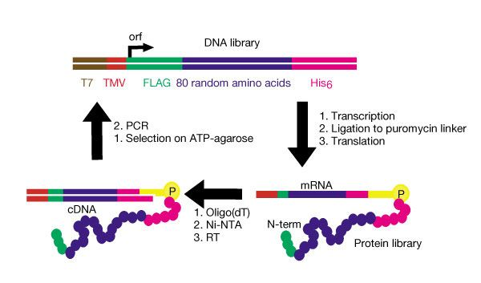
Keefe and Szostak’s description
Four distinct ATP binding peptides isolated.
”estimate that roughly 1 in 10¹¹ of all random-sequence proteins have ATP-binding activity comparable to the proteins isolated in this study”
from https://www.nature.com/articles/35070613

Slide 11
One of these in vitro selected peptides was crystalized by Lo Surdo, P., Walsh, M.A., Sollazzo, M.
From: https://www.nature.com/articles/nsmb745

Slide 12
GRASP ATP from the D-alanin D-alanine ligase

Slide 13
Rossman fold
ATPase beta SU
1BMF.pdb

Slide 14
In vitro selected peptide
1UW1.pdb

Slide 15
Convergent evolution of ATP binding sites did not lead to a similar arrangement of secondary structures building blocks.
ATP GRASP Rossmann fold In vitro evolved peptide

